Slide 1
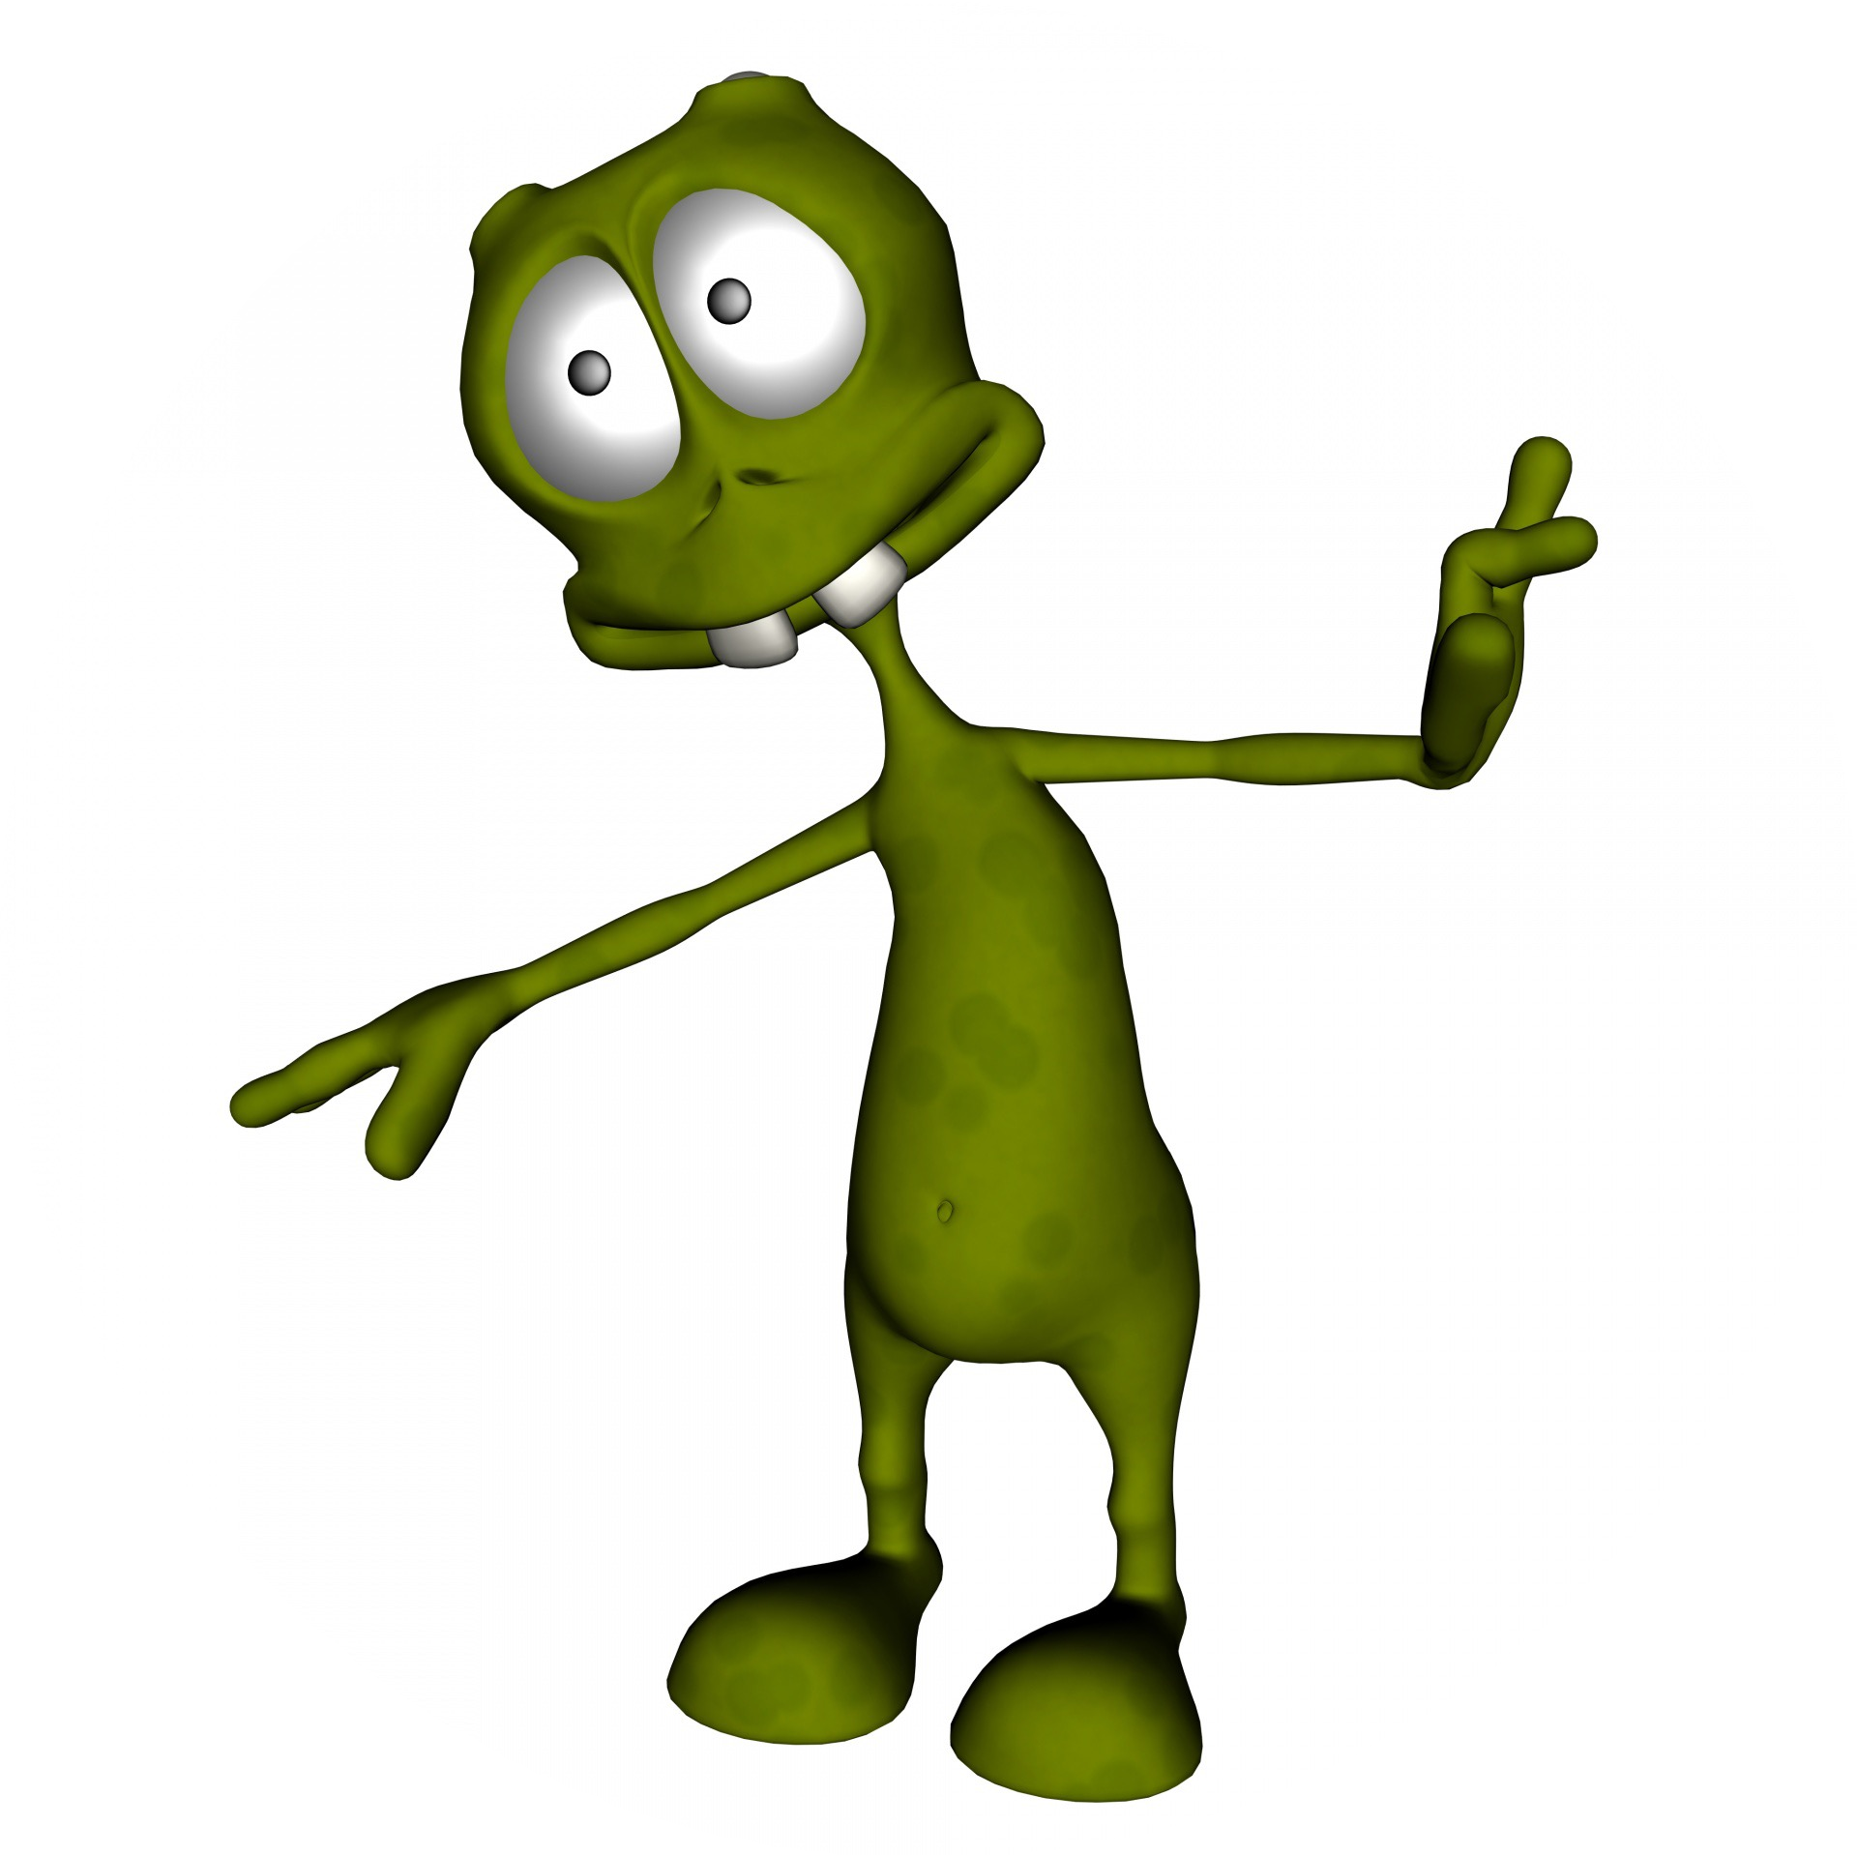
Alien minds

Slide 2
Overview
In this video, I talk about the challenges associated with learning about alien minds—not necessarily extraterrestrial minds, but minds very different from our own.
2
This Photo by Unknown Author is licensed under CC BY

Slide 3



Recap
We previously saw that there are important challenges associated with learning about other people’s minds.
Things are a lot more complicated when it comes to alien minds.
This Photo by Unknown Author is licensed under CC BY-ND

Slide 4
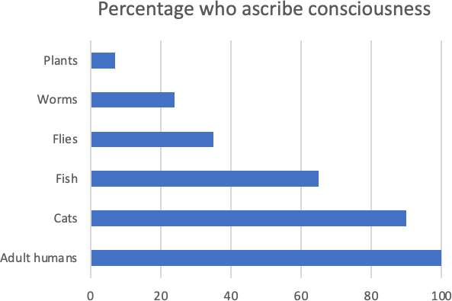
Non-human life forms
There is not much agreement among philosophers regarding where to draw the line between conscious and non-conscious life forms.
As this graph shows, the simpler creatures get, the less likely philosophers are to ascribe them consciousness, but there is no sharp cut off.

Slide 5
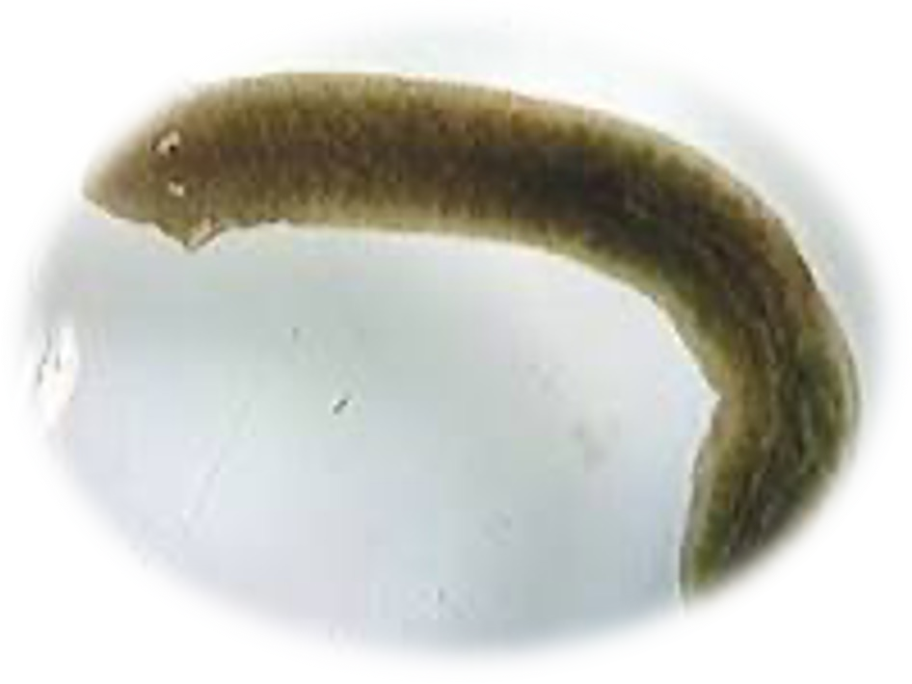

Octopuses
The case of octopuses is especially interesting because they are very different from us yet exhibit complex behaviour that suggests some intelligence and consciousness.
How different?
  Our last common ancestor is a simple flatworm that existed 750 million years ago (well before dinosaurs).
  Most of their neurons are in their tentacles, which seems to behave somewhat independently.

Slide 6
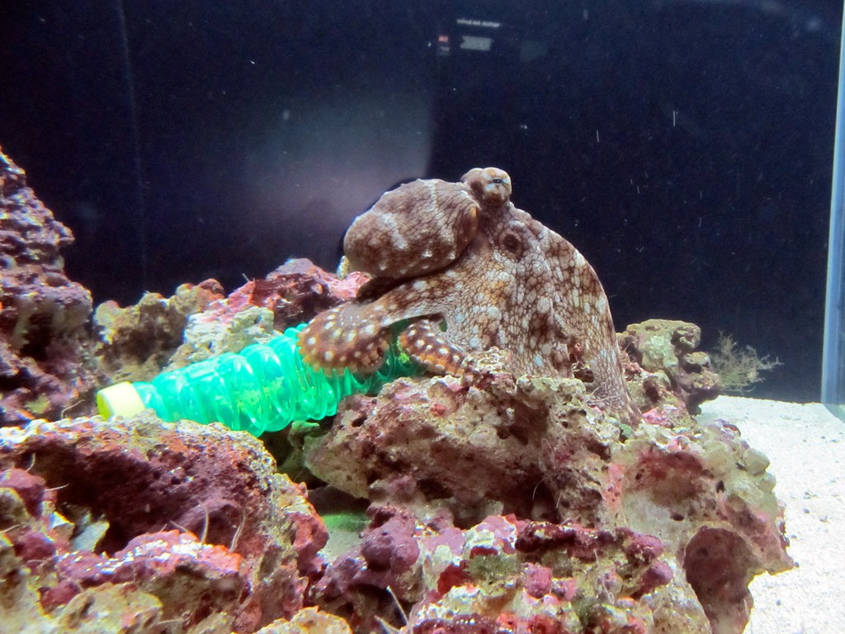
Octopuses
Despite their differences with us, octopuses have been observed using tools, solving puzzles, and playing tricks.
It seems almost obvious from their behaviour that they are conscious and have minds.
This Photo by Unknown Author is licensed under CC BY-SA

Slide 7
Some skepticism
But do we know for sure that octopuses are conscious?
Interestingly, many theories of consciousness seem to predict that they are not.
  Monitoring theories seem to require too much self-awareness.
  Most other theories associate consciousness with a “global workspace” of information processing that may not exist in octopuses because of the distributed nature of their nervous systems.
Should we take this as evidence against these theories or as evidence against consciousness in octopuses?

Slide 8

Other kinds of intelligence
It is even less clear what other forms of intelligence may be conscious.
  Could a future AI that works really well (nothing like today’s digital assistants!) be conscious?
    Today, it’s easy to imagine complex programs that communicate like humans by drawing on vast data but that do this completely unconsciously.
    But can we assume that very very complex machines will always be unconscious?
How could we tell if little creatures found in underground lakes on Mars are conscious?
This Photo by Unknown Author is licensed under CC BY

Slide 9
Justifying belief in alien consciousness
The arguments that we previously used to justify our beliefs in the mental states of other people don’t seem to apply to alien minds.
Let’s go back to these arguments.
This Photo by Unknown Author is licensed under CC BY
9

Slide 10
Perception
We cannot directly perceive the consciousness of an AI or octopus. Maybe we think octopuses “look” conscious, but can we trust that impression?

Slide 11
Analogy
We cannot reason by analogy.
In the case of normal humans, it’s reasonable to assume that very similar brains give raise to very similar kinds of mental states. But in the case of very different creatures, we don’t know if what it takes to make consciousness is preserved.

Slide 12
Inference to the best explanation
We cannot reason by inference to the best explanation.
In the case of normal humans, folk psychology may reasonably seem to offer the best explanation of their behaviour. But we have no comparable theory for alien minds.

Slide 13
The general problem
If we cannot directly observe (perceive) consciousness in alien minds and cannot reason by analogy or to the best explanation of behaviour, we need a better understanding of what is necessary and sufficient for a creature to be conscious.
That is, we need a theory of consciousness in general (not just in humans).

Slide 14
The general problem
There are many shapes a theory of consciousness could take (discussed in previous lectures).
  It could tell us that specific kinds of neural processes or structure sustain consciousness.
  It could tell us that consciousness is a matter of functional role.
  It could tell us that consciousness requires a non-physical ingredient.
  Etc.

Slide 15
The general problem
The problem is, we don’t have a theory of consciousness, and deciding what is the right theory of consciousness in general seems to require knowing already what is necessary and sufficient for consciousness.
When we choose a theory of consciousness, we choose at the same time whether we’re going to count octopuses, flies, and future AIs as conscious.
If there are multiple available theories and they make different predictions about alien minds, how can we choose between them?

Slide 16

Enters the explanatory gap
Remember that there seems to be an explanatory gap between phenomenal facts (facts about consciousness) and physical facts: we cannot by reasoning alone infer phenomenal facts from physical facts about the brain or anything else.
16
This Photo by Unknown Author is licensed under CC BY

Slide 17
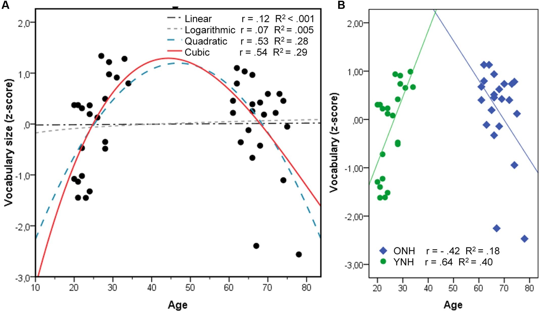
Enters the explanatory gap
Since there is an explanatory gap, we can only determine which physical states are associated with consciousness (and what kind of consciousness they are associated with) by extrapolating from the physical states observed in the cases where we know there is consciousness-–the cases of humans that report being conscious.
This Photo by Unknown Author is licensed under CC BY
17

Slide 18
Can we know which alien minds are conscious?
The problem is, it’s quite possible that different theories will “fit” the human data equally well while making different predictions in other cases.
In fact, the theories currently being entertained, such as monitoring and intentionalist theories, do make different predictions while fitting the human case roughly equally well when it comes to predicting which structures have consciousness.
Without closing the explanatory gap, it seems impossible to determine what forms of non-human intelligence are conscious!
18
This Photo by Unknown Author is licensed under CC BY

Slide 19
Another reason for pessimism
A distinct problem is that there does not seem to be an intelligible pattern relating the contents of consciousness with the physical structures that underpin it.
  There is nothing “pain-y” about the neurons that underpin pain
  Nothing green-y about the neurons that undermine the experience of green
  Etc.
I said we need to extrapolate a pattern from the human case and there may be more than one pattern that fits.
I believe there is in fact no intelligible pattern that fits the contents of consciousness!

Slide 20
Another reason for pessimism
In practice, we ascribe contents of consciousness based on behaviour:
  We assume that creatures that respond to light in the way that we do, using similar receptors, perceive colours as we do.
  We assume that creatures that pass the mirror test (that try to remove or take interest in a dot on their forehead) have some kind of sense of self similar to ours.
  Etc.
Those are reasonable guesses. However, when it comes to extrapolating to forms of consciousness with different physical underpinnings, we have no pattern to follow and behaviour is not a plausible guide.

Slide 21
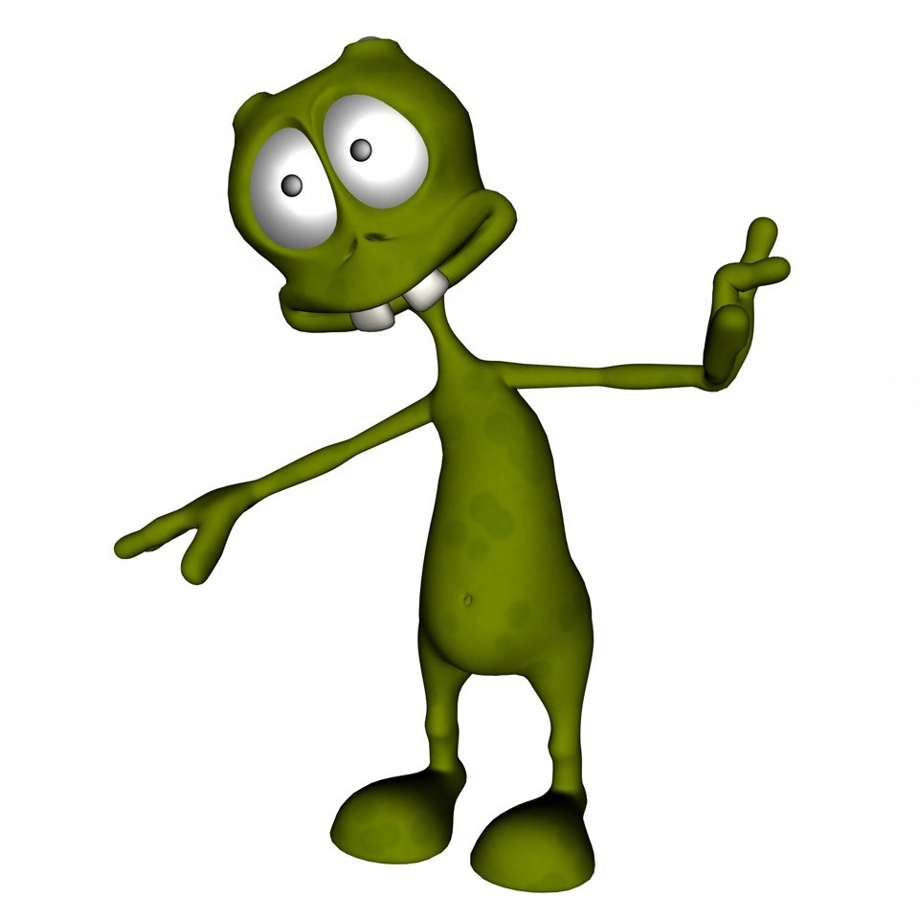
Summary
In summary, the situation is bleak when it comes to determining what alien minds have consciousness and what their consciousness is like.
There seems to be principled difficulties that stand in the way so long as there is an explanatory gap.

